Slide 1
Course
Management System
Made By:
Gautam Sood
Roll No.:
1911985065

Slide 2
Problem Statement
How teacher can maintain all the courses he teach?
How students can give feedbacks to teacher?
How the parents monitor their children assignments and learning materials?
How the students know the objectives of subjects taught in the school?

Slide 3
PURPOSE OF CMS
This course management system is an online management software application designed for educational institutions.
The primary goal of the project is to facilitate seamless interaction between students and instructors in schools, colleges, and universities concerning the submission of projects, assignments, thesis, and receiving feedback from instructors. LMS is designed to help an individual to develop, manage and provide online courses and programs to learn.
It provides a platform for the students and instructors to learn and highlight their skills wherever and whenever they want as per their convenience.
Asking Doubts and giving feedbacks becomes very convenient.

Slide 4



MODULES
Admin
Teacher
1
3
2
Student

Slide 5
Module Details
01
02
03
Student
Teacher
This module is designed for the usage of students. They can log to view their coursework, submit their projects, get feedback from instructors, etc.
This module is for the instructors who can log in and check the projects submitted by the students, communicate ,etc.
Admin
This module is designed exclusively for managing administrative functions like creating accounts for students and instructors, creating the curriculum, coding the subjects,etc.

Slide 6
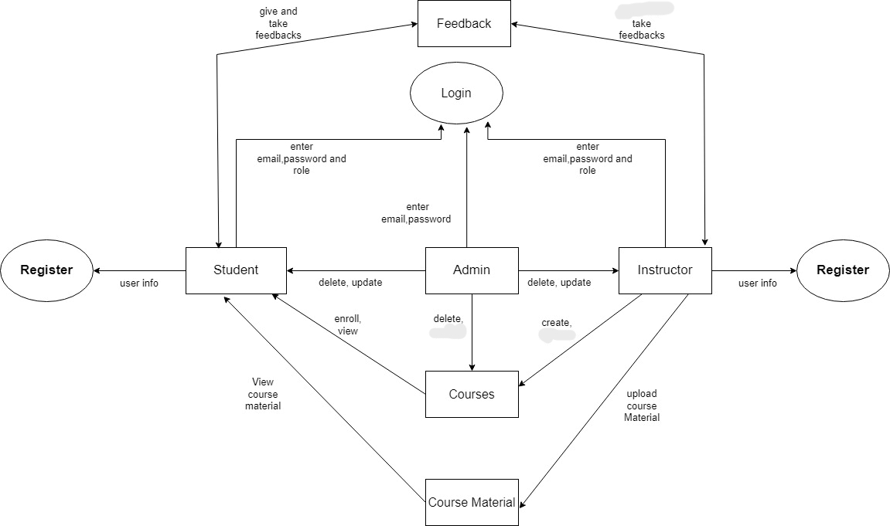
Data Flow Diagram

Slide 7
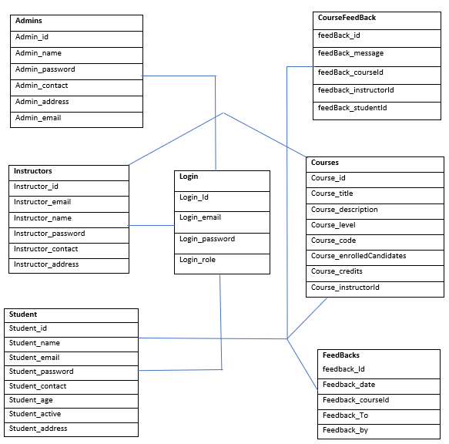
ER Diagram

Slide 8
Tech. Used
Front-end technologies:
HTML, CSS, JS, React JS, Axios, Formic, React Router, Tailwind, React-Query, JS-cookie.
HTML: HTML stands for Hyper Text Markup Language, which is the most widely used language on Web to develop web pages. HTML was developed with the intent of defining the structure of documents like headings, paragraphs, lists, and so forth to facilitate the sharing of scientific information between researchers. Now, HTML is being widely used to format web pages with the help of different tags available in HTML language.
CSS: CSS is acronym of Cascading Style Sheets. It helps to define the presentation of HTML elements as a separate file known as CSS file having .css extension. CSS helps to change formatting of any HTML element by just making changes at one place. All changes made would be reflected automatically to all of the web pages of the website in which that element appeared.

Slide 9
JS: JavaScript (js) is a light-weight object-oriented programming language which is used by several websites for scripting the webpages. It is an interpreted, full-fledged programming language that enables dynamic interactivity on websites when applied to an HTML document. With JavaScript, users can build modern web applications to interact directly without reloading the page every time. In addition to web browsers, databases such as CouchDB and MongoDB uses JavaScript as their scripting and query language.
React JS: React (also known as React.js or React JS) is a free and open-source front-end JavaScript library for building user interfaces based on UI components. It is maintained by Meta (formerly Facebook) and a community of individual developers and companies. React can be used as a base in the development of single-page, mobile, or server-rendered applications with frameworks like Next.js. However, React is only concerned with state management and rendering that state to the DOM, so creating React applications usually requires the use of additional libraries for routing, as well as certain client-side functionality.

Slide 10
Axios : In ReactJS, Axios is a library that serves to create HTTP requests that are present externally. It is evident from the fact that we may sometimes in React applications need to get data from the external source. It is quite difficult to fetch such data so that they can be normally shown on the website. Thus, it helps in retrieving the data thereby adding it to the state to facilitate the application whenever the requirement arises.
React Router: React Router is a standard library for routing in React. It enables the navigation among views of various components in a React Application, allows changing the browser URL, and keeps the UI in sync with the URL. Let us create a simple application to React to understand how the React Router works. The application will contain three components: home component, about a component, and contact component. We will use React Router to navigate between these components.
Formik: Formik is a small group of React components and hooks for building forms in React and React Native. It helps with the three most important parts: Getting values in and out of form state, Validation and error messages, Handling form submission.

Slide 11
Tailwind: Tailwind CSS is a utility-first CSS framework for rapidly building custom user interfaces. It is a highly customizable, low-level CSS framework that gives you all of the building blocks you need to build bespoke designs without any annoying opinionated styles you have to fight to override. The beauty of this thing called tailwind is it doesn’t impose design specification or how your site should look like, you simply bring tiny components together to construct a user interface that is unique. What Tailwind simply does is take a ‘raw’ CSS file, processes this CSS file over a configuration file, and produces an output.
React-Query: React Query is often described as the missing data-fetching library for React, but in more technical terms, it makes fetching, caching, synchronizing and updating server state in your React applications a breeze. React Query provides us custom hooks like “useQuery” to fetch data. Under the hood, these hooks manage lots of things such as caching data after the initial fetch, re-fetching data in the background, etc.
JS Cookie: A cookie is an amount of information that persists between a server-side and a client-side. A web browser stores this information at the time of browsing. A cookie contains the information as a string generally in the form of a name-value pair separated by semi-colons. It maintains the state of a user and remembers the user's information among all the web pages.

Slide 12
Backend technologies: Express JS, JWT, Node JS, MongoDB, Cookie-Parser, Bcrypt JS, CORS, Multer, Cloudinary, NodeMailer.
Node JS: Node.js is an open-source, cross-platform, back-end JavaScript runtime environment that runs on the V8 engine and executes JavaScript code outside a web browser. Node.js lets developers use JavaScript to write command line tools and for server-side scripting—running scripts server-side to produce dynamic web page content before the page is sent to the user's web browser.
Express: Express.js, or simply Express, is a back end web application framework for Node.js, released as free and open-source software under the MIT License. It is designed for building web applications and APIs. It has been called the de facto standard server framework for Node.js. Express is the back-end component of popular development stacks like the MEAN, MERN or MEVN stack, together with the MongoDB database software and a JavaScript front-end framework or library.

Slide 13
JWT : JWT, or JSON Web Token, is an open standard used to share security information between two parties — a client and a server. Each JWT contains encoded JSON objects, including a set of claims. JWTs are signed using a cryptographic algorithm to ensure that the claims cannot be altered after the token is issued.
Mongo DB: Mongo DB is an open-source document database that provides high performance, high availability, and automatic scaling. In simple words, you can say that - Mongo DB is a document-oriented database. It is an open source product, developed and supported by a company named 10gen. MongoDB is a scalable, open source, high performance, document-oriented database.
Cookie-parser: cookie-parser is a middleware which parses cookies attached to the client request object. To use it, we will require it in our index. js file; this can be used the same way as we use other middleware.

Slide 14
BcryptJS: Optimized bcrypt in JavaScript with zero dependencies. Compatible to the C++ bcrypt binding on node.js and also working in the browser. Besides incorporating a salt to protect against rainbow table attacks, bcrypt is an adaptive function: over time, the iteration count can be increased to make it slower, so it remains resistant to brute-force search attacks even with increasing computation power.
CORS: Cross-Origin Resource Sharing (CORS) is an HTTP-header based mechanism that allows a server to indicate any origins (domain, scheme, or port) other than its own from which a browser should permit loading resources. CORS also relies on a mechanism by which browsers make a "preflight" request to the server hosting the cross-origin resource, in order to check that the server will permit the actual request. In that preflight, the browser sends headers that indicate the HTTP method and headers that will be used in the actual request.
Multer: Multer is a node.js middleware for handling multipart/form-data, which is primarily used for uploading files. It is written on top of busboy for maximum efficiency.

Slide 15
Cloudinary: Cloudinary's Node.js SDK simplifies the generation of transformation URLs for easy embedding of assets in your Node.js application. After you or your users have uploaded image assets to Cloudinary, you can deliver them via dynamic URLs. You can include instructions in your dynamic URLs that tell Cloudinary to transform your assets using a set of transformation parameters. All transformations are performed automatically in the cloud and your transformed assets are automatically optimized before they are routed through a fast CDN to the end user for optimal user experience.

Slide 16
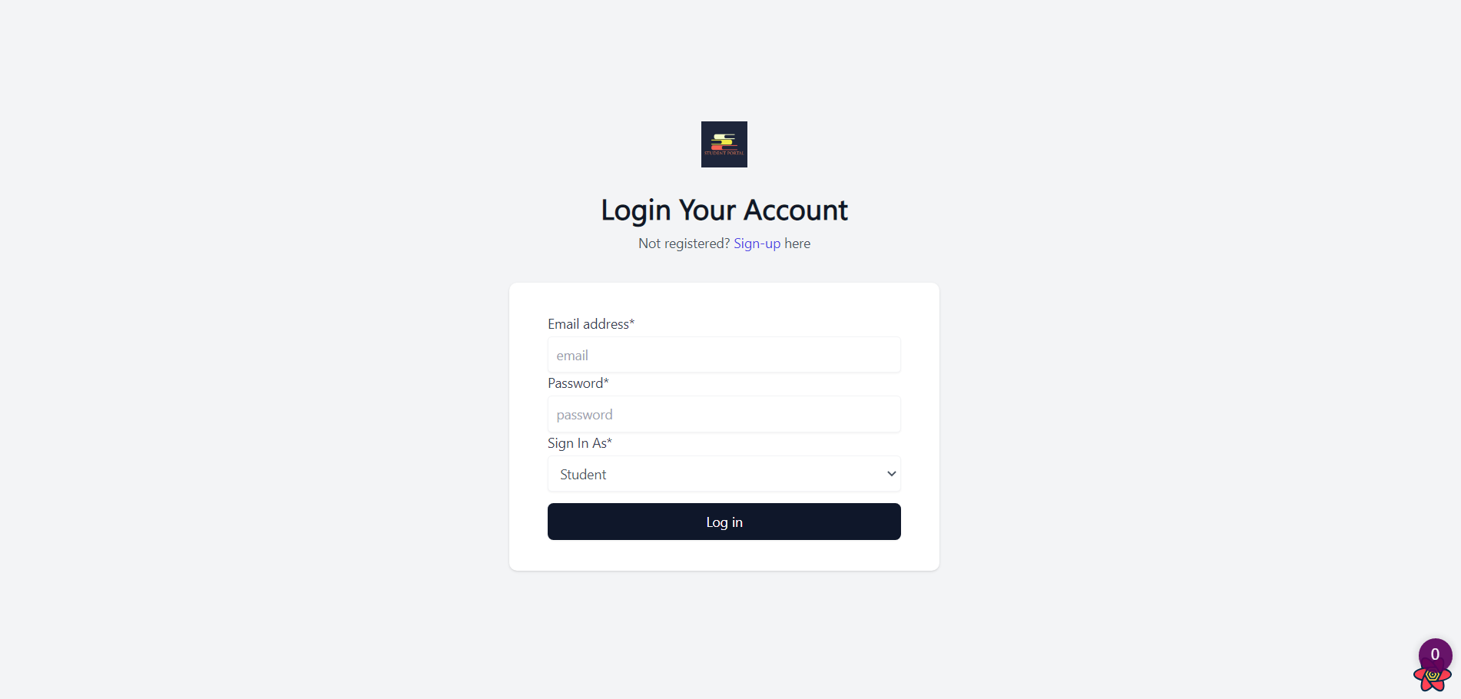

Slide 17
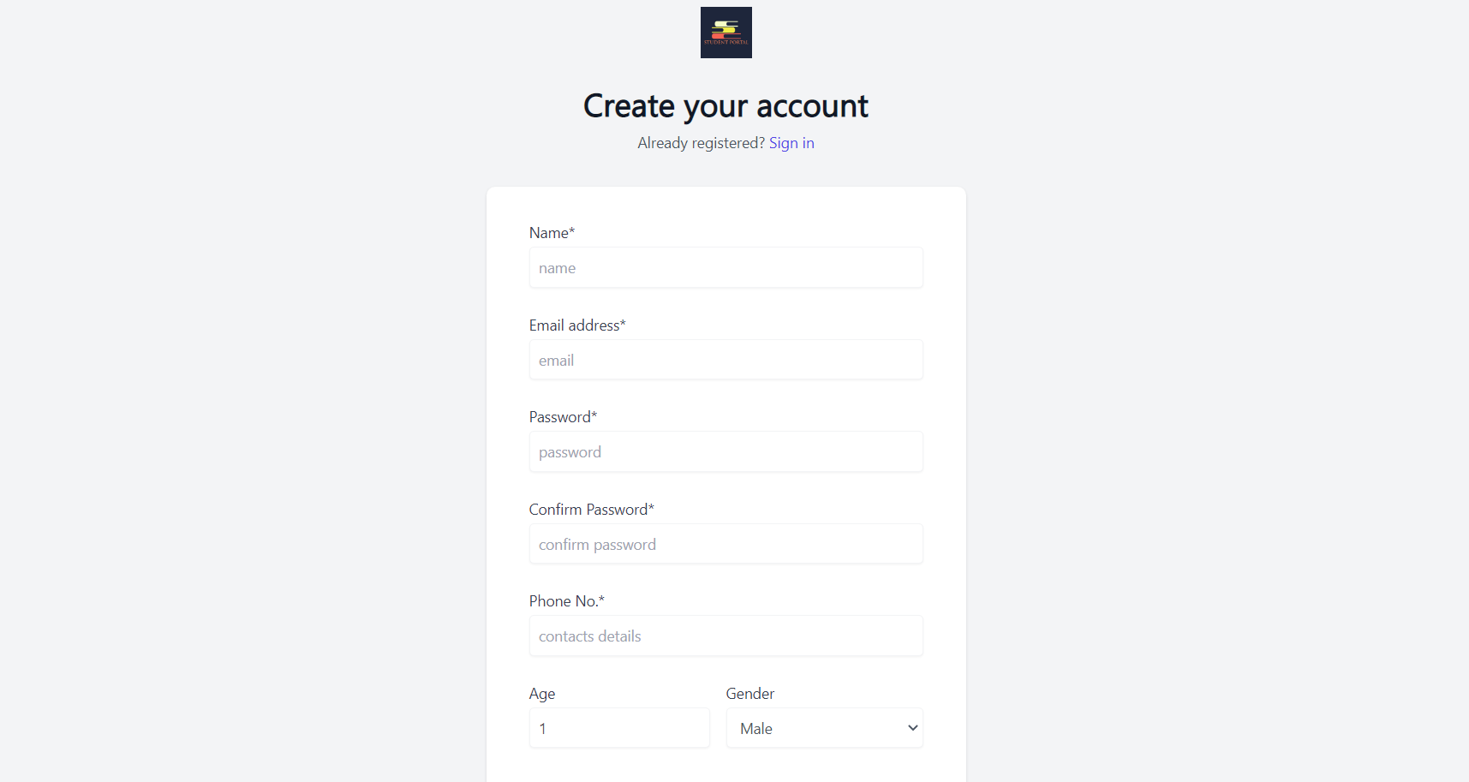

Slide 18
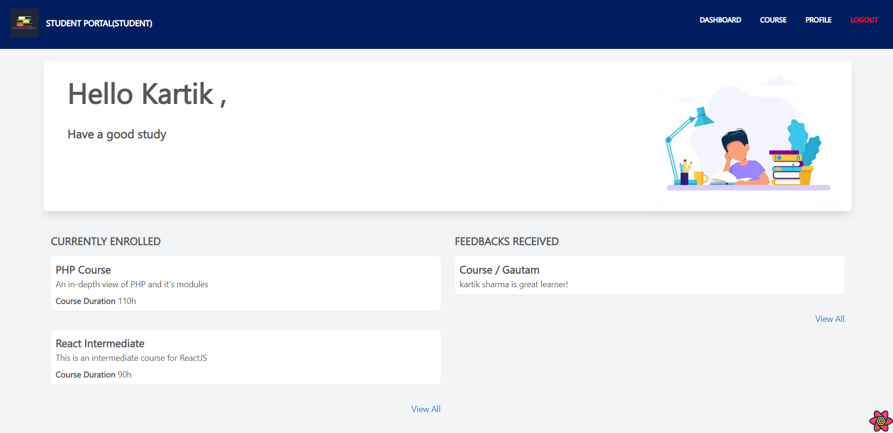

Slide 19
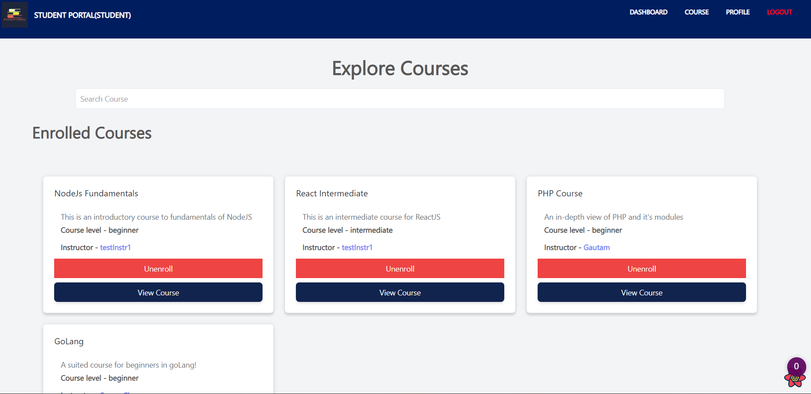

Slide 20
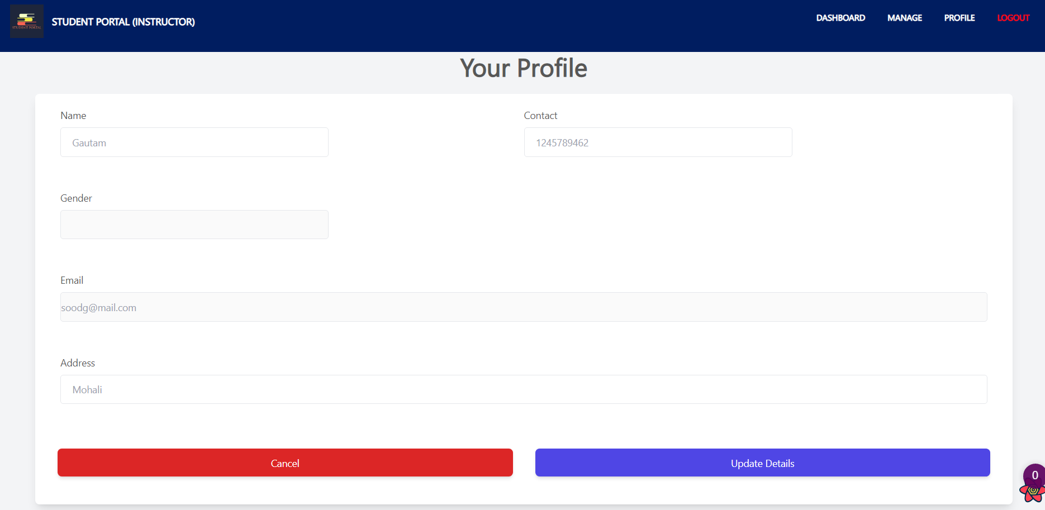

Slide 21
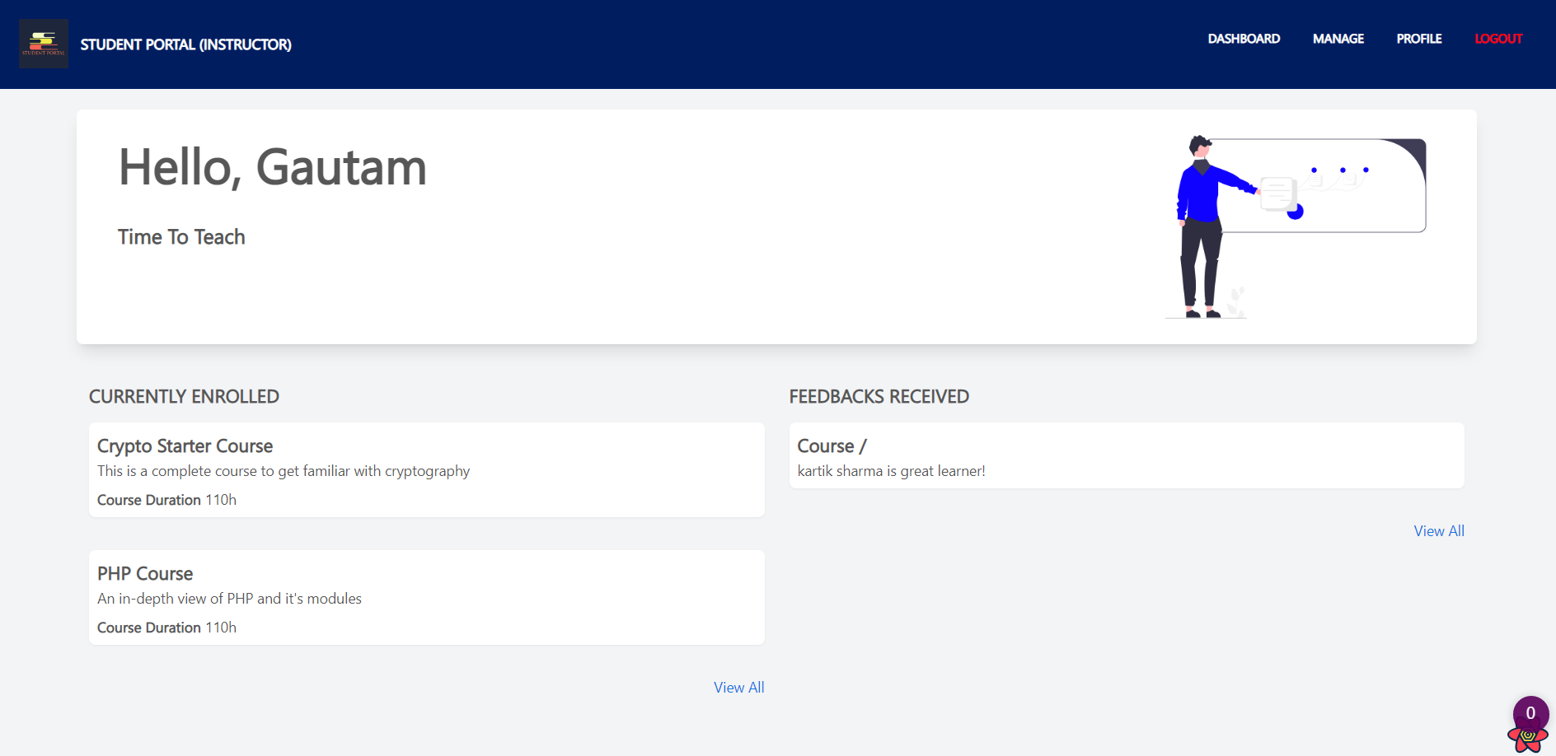

Slide 22
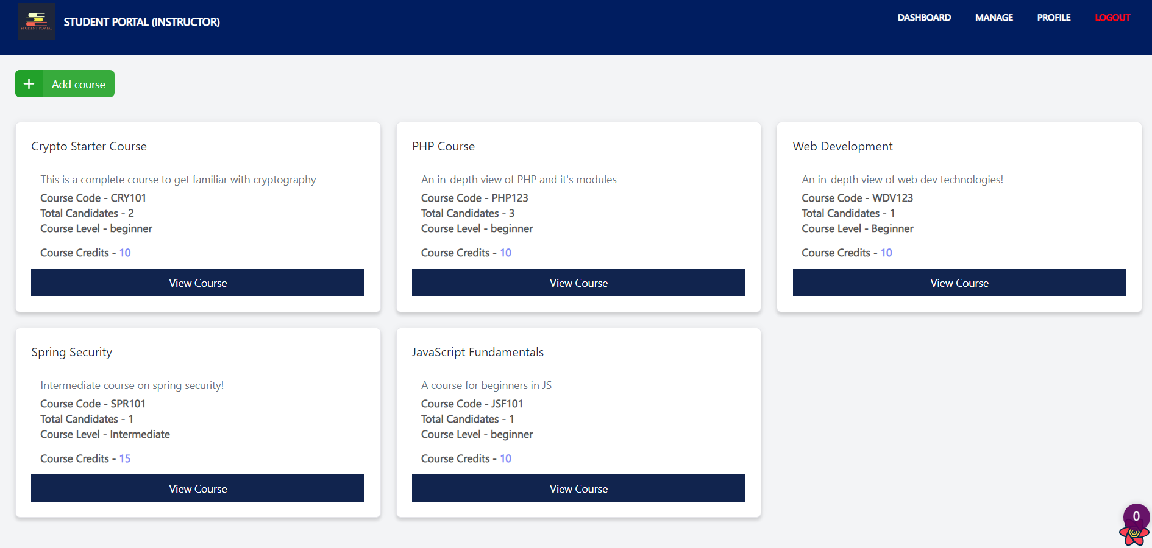

Slide 23
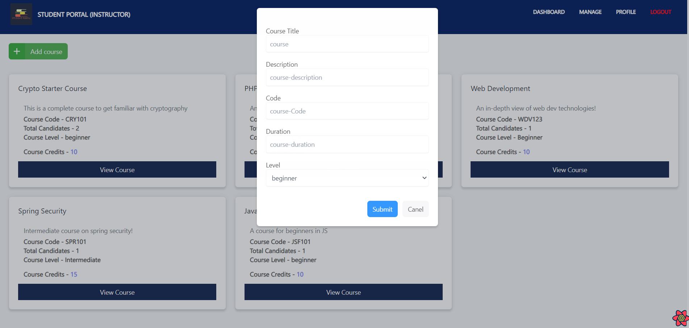

Slide 24
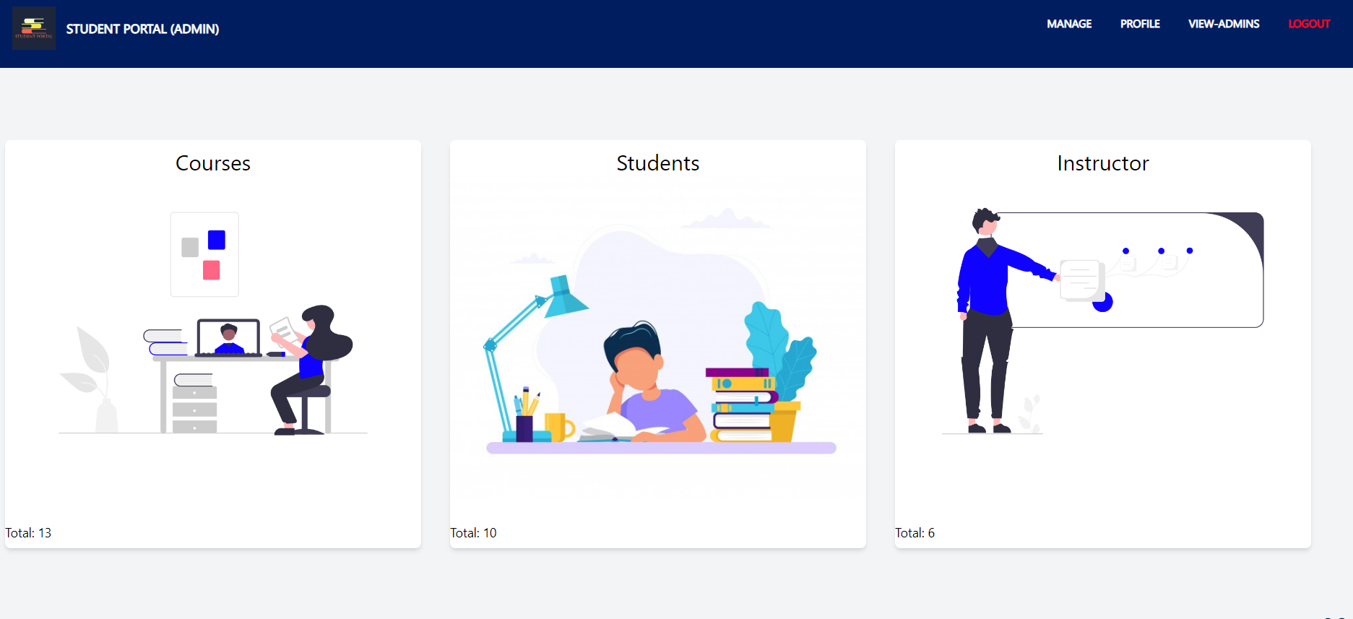

Slide 25
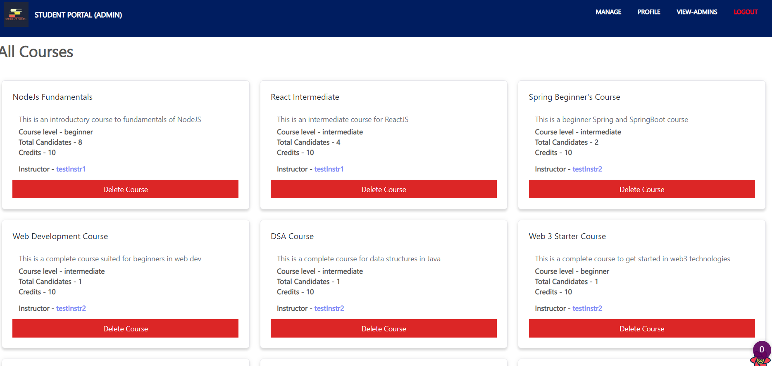

Slide 26
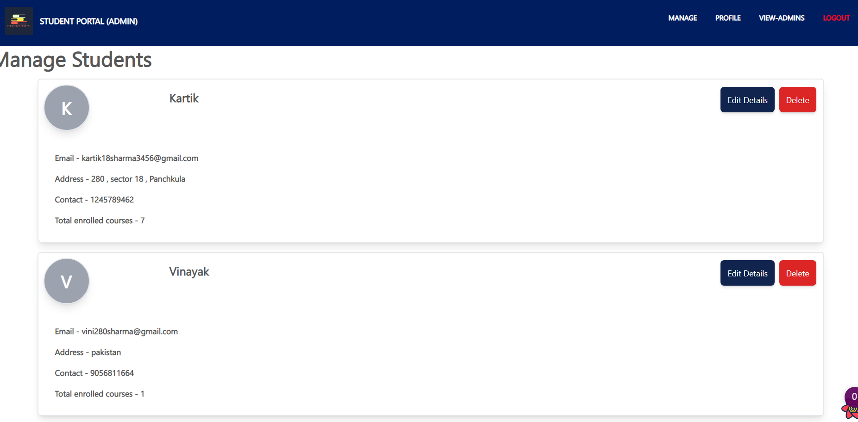

Slide 27
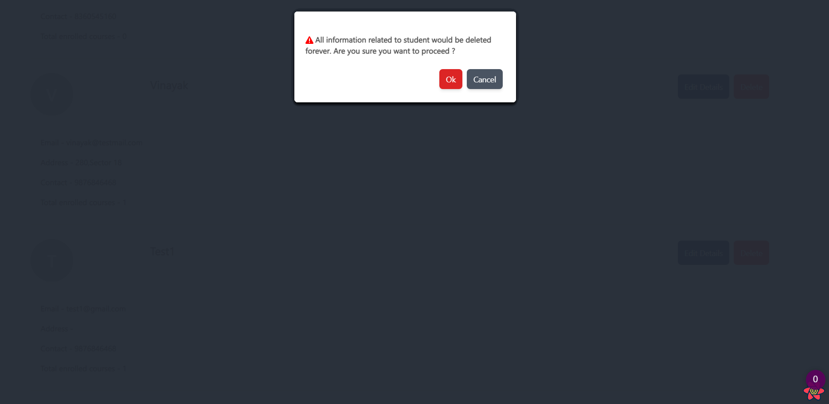

Slide 28
Future Scope
Student Assignments:
It provides opportunity for students to learn, practice and demonstrate they have achieved the learning goals. It provides the evidence for the teacher that the students have achieved the goals.Instructor can give students assignments and student can add their assignments
2. One to One chat application.
3. Forget Password.
4. Progress Bar charts

Slide 29
Thank You

